Slide 1
Enterprise Europe Network
Common aspects – our experience
Bianca Tătaru
West RDA - Ro-Boost SMEs Consortium
EEN national Meeting - June 2017
Notes:
Introduction: explain that what we do – in a nutshell – is to help ambitious SMEs innovate and grow internationally.

Slide 2
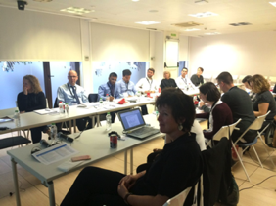
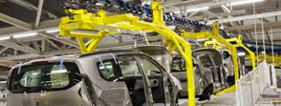
Enterprise Europe Network | June 2017 | 2
Automotive Sector Group
Fields covered: Intelligent transport; GPS applications; Production of commercial and passenger vehicles; Motorsport technologies Supplier chains ; "Mobility" as a concept
Members meet twice a year;
The agenda usually includes organizing events (brokerage), building business partnerships between customers from different countries, partnerships in EC-funded projects, etc.
LOCAL
EXPERTS

Slide 3
Enterprise Europe Network I June 2017 | 3
Communication Facts & figures 2015 -2016
1577 unique clients were reached in 2015
926 in 2016 via electronic alerts, newsletters, and invitations
8.659 recipients were reached via social media in 2016, amounting to
16.686 reach-out in the 2015-2016 period
The Consortium’s website was launched successfully in the beginning of 2016, numbering 18.941 unique visitors by end of the year

Slide 4
Enterprise Europe Network I June 2017 | 4
Communication Plan 2017 - 2018
Increase visibility of the network through continuous promotion (media relationships, organize events for information and dissemination, social media)
Build a strong identity and commitment for the consortium, host organisations and partner regions
Raise awareness towards results, impact, opportunities and success stories
Establish and consolidate collaboration with local stakeholders
Ensure to “reach people who matter”
Promote the key messages in all communication activities

Slide 5
Enterprise Europe Network | June 2017 | 5
Upcomming events 2017
July 2017 - Enterprise Europe Network Caravan in West Region
November 8, 2017 – Regional Innovation Fair & Innomatch 2017

Slide 6
Enterprise Europe Network – servicii de suport pentru afaceri | 21 Iunie 2017 | 6
https://www.facebook.com/Tehimpuls/videos/1138116529628481/

Slide 7
Contact
Consorțiul Ro-Boost SMEs
West Regional Development Agnecy
Proclamatia de la Timisoara no. 5
Timisoara, 300054, Romania,
Tel: +40 256 491 981, Fax: +40 256 491 923
Email: office-een@adrvest.ro
Visit
to find the Network near you
Follow us at
www.eenroboost.ro

